Slide 1
Group 1
TAP Mobile
Introduction
Project Management
Requirements
Life Cycle Plan
Feasibility Evidence
Architecture
Prototype
Discussion
System Overview

Slide 2
Project Management
Introduction
Project Management
System Overview
Requirements
Life Cycle Plan
Feasibility Evidence
Architecture
Prototype
Discussion

Slide 3
TAP Team - Roles
Team Member | Member Role
Elisabeth Brooks | Project Manager
Andrew Borba | Prototyper
Jorge Go | Feasibility Analyst
Katherine Hu | Lifecycle Planner
Nakul Joshi | Software Architect
Ian Malave | Requirements Engineer
Rishi Mukhopadyay | Operational Concept Engineer
Introduction
Project Management
System Overview
Requirements
Life Cycle Plan
Feasibility Evidence
Architecture
Prototype
Discussion

Slide 4
TAP Team - Responsibilities
Team Member | Responsibilities
Elisabeth Brooks | In charge of keeping team on track, updating project management tool, assign tasks to team members, and hold team accountable for their responsibilities. Schedule meetings
Andrew Borba | Works on front end prototype design and implementation
Jorge Go | Risk Identification and Analysis, Risk Mitigation Plans, Business Cases and Cost-Benefit Analysis.
Katherine Hu | Lifecycle Planner. Assists in keeping track of the different updates for the project
Nakul Joshi | In charge of high level system design. Maintaining documents and compiling through LaTeX
Ian Malave | Works on the front end prototype and implementation.
Rishi Mukhopadyay | Operational Concept Engineer
Introduction
Project Management
System Overview
Requirements
Life Cycle Plan
Feasibility Evidence
Architecture
Prototype
Discussion

Slide 5
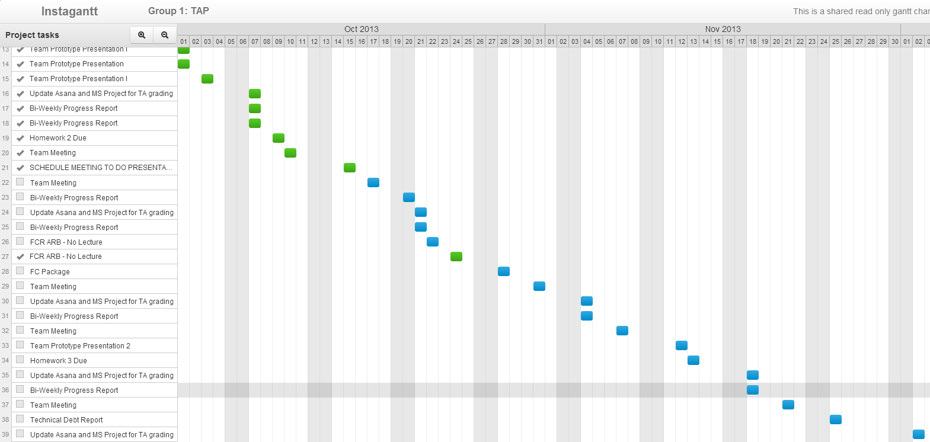



Project Management
Communication Tools
Asana
Gantt app extension
GroupMe
Facebook Group
Presentation Collaboration
SkyDrive PowerPoint WebApp
Code and Documentation
GitHub
Introduction
Project Management
System Overview
Requirements
Life Cycle Plan
Feasibility Evidence
Architecture
Prototype
Discussion

Slide 6
Strengths and Weaknesses
Operational View
Strength
Weakness
Technical View
Strength
Weakness
Good team morale- common goal, and always complete necessary tasks
Disagreement on documentation and communication tools
Clear project vision, have necessary technical tools
Little experience with large-scale, high quality mobile app development
Introduction
Project Management
System Overview
Requirements
Life Cycle Plan
Feasibility Evidence
Architecture
Prototype
Discussion

Slide 7
Technical Concerns
Near Field Communication
Can use QR codes until this technology is developed
Constant Database Updates Regardless of Cell Service
Hard coded backup data
Small Time Window for Updates
Trains run constantly and schedules and purchasing options needs to be accessible at all times
Introduction
Project Management
System Overview
Requirements
Life Cycle Plan
Feasibility Evidence
Architecture
Prototype
Discussion

Slide 8
Operational Risk
Synchronization of Schedules
Always show multiple schedule options
Require cash backup
No Option to Differentiate and Verify Prices
One price for all tickets
Can’t verify payment options
Introduction
Project Management
System Overview
Requirements
Life Cycle Plan
Feasibility Evidence
Architecture
Prototype
Discussion

Slide 9
Tools Used
Visio
Fluid UI
Implementation
HTML
Management
Prototyping
PhoneGap
Asana
GroupMe
Facebook
Introduction
Project Management
System Overview
Requirements
Life Cycle Plan
Feasibility Evidence
Architecture
Prototype
Discussion

Slide 10
System Overview and Purpose
Introduction
Project Management
System Overview
Requirements
Life Cycle Plan
Feasibility Evidence
Architecture
Prototype
Discussion

Slide 11
System Purpose
Convenience to metro riders
Eliminates the need to keep track of physical TAP cards
Decrease cost for the LA Metro and ticket buyers by eliminating physical footprint.
Increase efficiency of the public transport system through advancing technologically.
Introduction
Project Management
System Overview
Requirements
Life Cycle Plan
Feasibility Evidence
Architecture
Prototype
Discussion

Slide 12
Shared Vision
Introduction
Project Management
System Overview
Requirements
Life Cycle Plan
Feasibility Evidence
Architecture
Prototype
Discussion

Slide 13
System Overview
Key Partners
LA Metro
Key Activities
Software Design and Development
Integration with Metro Infrastructure
Application Marketing
Key Resources
Development Team
Phonegap API
NFC Technology
QR Technology
Introduction
Project Management
System Overview
Requirements
Life Cycle Plan
Feasibility Evidence
Architecture
Prototype
Discussion

Slide 14
System Overview(contd.)
Value Proposition
Convenience for customers to purchase and use metro tickets
Elimination of physical tickets
Technological advancement of transportation systems
Customer Relation
LA Metro
Apple Appstore
Android Store
Windows Phone Marketplace
Channels
Application Stores
LA Metro Website
Posters and Billboards at Stations
Introduction
Project Management
System Overview
Requirements
Life Cycle Plan
Feasibility Evidence
Architecture
Prototype
Discussion

Slide 15
System Overview(contd.)
Customer Segments
Transportation Companies
Cost Structure
Development Team
Back End System Administrator
Revenue Streams
Flat fee for project implementation
Recurring fee per ticket sale through application
Introduction
Project Management
System Overview
Requirements
Life Cycle Plan
Feasibility Evidence
Architecture
Prototype
Discussion

Slide 16
System Boundary & Environment
Ticket purchasing & authorization system
Metro
Riders
Ticket purchase through mobile application
Board metro through using smartphones
Historic ticket purchases
Train Schedules
Ticket re-pricing facilities for administrators
Ability to add/change ticket types.
Support
Hardware
Host servers
QR Scanners
NFC Transponder
Individual Smartphones/Tablets
Software
PhoneGap
PHP Server
mySQL
TAP System Administrator
LA Metro Schedule Feed
LA Metro Pricing Database
LA Metro Rider Database
Introduction
Project Management
System Overview
Requirements
Life Cycle Plan
Feasibility Evidence
Architecture
Prototype
Discussion

Slide 17
Element Relationship Diagram
Mobile Application
D
A
T
A
B
A
S
E
Add Balance
Purchasing Site
Retrieve & Update
User Account Balance
View Balance
Authentication and Authorization
Purchase Pass
U
S
E
R
Login
Use
Ticket
Ticket Pricing
Train Schedule
Admin Control Panel
Use Ticket
Update
Ticket/
Train Information
Tap Reader
Metro
Administrator
Update User Acct Balance
Introduction
Project Management
System Overview
Requirements
Life Cycle Plan
Feasibility Evidence
Architecture
Prototype
Discussion

Slide 18
Life Cycle Plan – Incremental Commitment Spiral Model (ICSM)
Introduction
Project Management
System Overview
Requirements
Life Cycle Plan
Feasibility Evidence
Architecture
Prototype
Discussion

Slide 19
Requirements
Introduction
Project Management
System Overview
Requirements
Life Cycle Plan
Feasibility Evidence
Architecture
Prototype
Discussion

Slide 20
Requirements (new mandatory requirements)
The application shall support three ( 3) dependents' accounts that use the same financial information.
The application shall allow users to purchase all currently offered TAP passes except for discount passes.
If there is no connectivity when attempting a transaction, the application shall attempt to use bluetooth to proceed with the transaction.
The application shall allow users to connect to their online TAP accounts.
Introduction
Project Management
System Overview
Requirements
Life Cycle Plan
Feasibility Evidence
Architecture
Prototype
Discussion

Slide 21
Requirements (continued mandatory requirements)
The application shall support the iOS and Android mobile platforms.
If it is a user's first-time opening the application, it shall prompt the user to create an account.
The application shall retrieve the user's location at intervals of 120 ± 10 seconds.
Users shall be able to choose between using TAP passes, their TAP card balance, and credit card to pay for fares.
The application shall store unused virtual tickets for at least one (1) year.
The application shall unlock turnstiles at necessary locations when a user uses their ticket.
The user shall be able to delete their credit card information from the application.
The user shall be able to delete their account.
Introduction
Project Management
System Overview
Requirements
Life Cycle Plan
Feasibility Evidence
Architecture
Prototype
Discussion

Slide 22
Requirements (continued mandatory requirements)
If the user selects to purchase a ticket, their selected payment method will be charged for the price of the train stop's ticket.
If the payment does not process, an error message shall be displayed and the order shall not be accepted.
If the transaction succeeds, the application shall create a virtual ticket.
If the user selects to use their ticket, the application shall signal the gate/reader up to a maximum of 3 attempts at 20 ± 5 second intervals to open.
If the application is unsuccessful on the 3rd attempt, an error message shall be displayed.
Otherwise, the turnstile is unlocked, permitting the user to pass through.
Introduction
Project Management
System Overview
Requirements
Life Cycle Plan
Feasibility Evidence
Architecture
Prototype
Discussion

Slide 23
Requirements (lowered priority items)
The application shall support a web interface for other mobile devices.
The application shall display updated train stop information at intervals of 30 ± 5 seconds.
Users shall be able to set up recurring payment for monthly passes.
The application shall store virtual used tickets for at least thirty (30) days.
Introduction
Project Management
System Overview
Requirements
Life Cycle Plan
Feasibility Evidence
Architecture
Prototype
Discussion

Slide 24
Architecture
Introduction
Project Management
System Overview
Requirements
Life Cycle Plan
Feasibility Evidence
Architecture
Prototype
Discussion

Slide 25
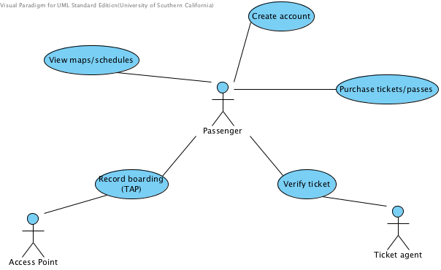
Use Case Diagram
Introduction
Project Management
System Overview
Requirements
Life Cycle Plan
Feasibility Evidence
Architecture
Prototype
Discussion

Slide 26
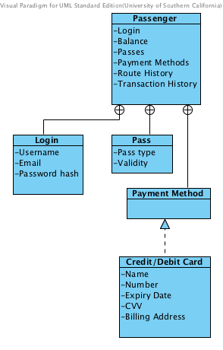
Class Diagram
Added need for Passenger class
Associated Fields shown in diagram
Route/Schedule information can be modeled by reusing existing classes in Metro infrastructure
High level of abstraction allows for flexible design
Introduction
Project Management
System Overview
Requirements
Life Cycle Plan
Feasibility Evidence
Architecture
Prototype
Discussion

Slide 27
COTS
PhoneGap
Allows for simultaneous development on multiple platforms
Enables portable apps
Fluid UI
Prototype development
Introduction
Project Management
System Overview
Requirements
Life Cycle Plan
Feasibility Evidence
Architecture
Prototype
Discussion

Slide 28
Prototype
Introduction
Project Management
System Overview
Requirements
Life Cycle Plan
Feasibility Evidence
Architecture
Prototype
Discussion

Slide 29
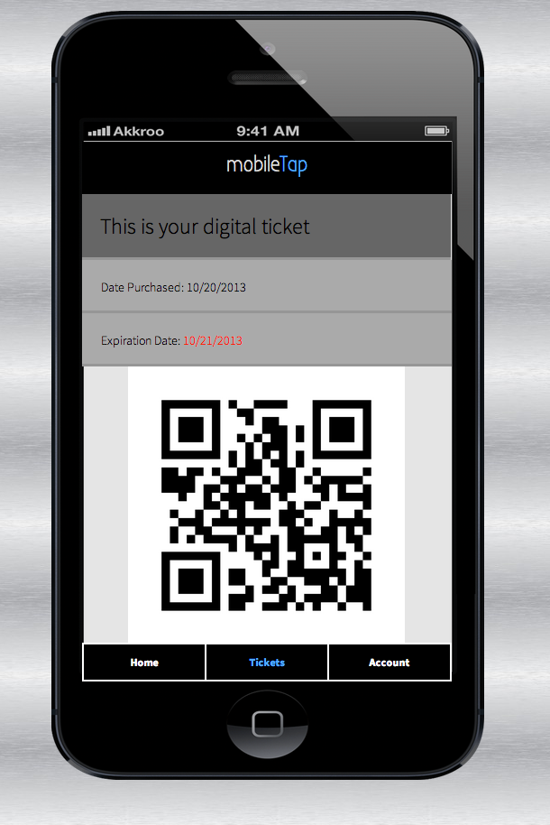
App Prototype
Introduction
Project Management
System Overview
Requirements
Life Cycle Plan
Feasibility Evidence
Architecture
Prototype
Discussion

Slide 30
Life Cycle Plan
Introduction
Project Management
System Overview
Requirements
Life Cycle Plan
Feasibility Evidence
Architecture
Prototype
Discussion

Slide 31
Life Cycle Plan – Exploration
Consisted of our research into what the market needs/the next step in transit technology
Revealed that there is already infrastructure in place
To promote technological advancement, we want to transition from physical cards to mobile app
Research transitioned us from focusing solely on LA Metro trains to all transit serviced by TAP
Introduction
Project Management
System Overview
Requirements
Life Cycle Plan
Feasibility Evidence
Architecture
Prototype
Discussion

Slide 32
Life Cycle Plan – Valuation
Valuation phase consisted of reviewing major risks and their advantages and disadvantages
Developed operational concept
Prioritized requirements – QR code over NFC
Introduction
Project Management
System Overview
Requirements
Life Cycle Plan
Feasibility Evidence
Architecture
Prototype
Discussion

Slide 33
Life Cycle Plan – Foundation
Developed system and software architecture
Still in the process of creating developmental iteration plan for the development phase
Introduction
Project Management
System Overview
Requirements
Life Cycle Plan
Feasibility Evidence
Architecture
Prototype
Discussion

Slide 34
Life Cycle Plan – Foundation, Development, Operation
Phase 2 to be completed Spring 2014
Introduction
Project Management
System Overview
Requirements
Life Cycle Plan
Feasibility Evidence
Architecture
Prototype
Discussion

Slide 35
Life Cycle Plan – NDI Intensive System
Phone Gap
Fluid UI
QR Code SDK/NFC Technology
Spent less time in foundations phase
Introduction
Project Management
System Overview
Requirements
Life Cycle Plan
Feasibility Evidence
Architecture
Prototype
Discussion

Slide 36
Key Stakeholders Responsibilities
LA Metro (POC)
TAP works with multiple transportation systems, using LA Metro as a proof of concept with our TAP App
Ensures the connectivity and stability between TAP and LA Metro infrastructure
TAP
Introduction
Project Management
System Overview
Requirements
Life Cycle Plan
Feasibility Evidence
Architecture
Prototype
Discussion

Slide 37
Key Stakeholders Responsibilities
TAP Mobile Team (477a)
Ian: Requirements Engineer
Katherine: Life Cycle Planner
Lizz: Project Manager
Rishi: Operational Concept Engineer
Nakul: Software Architect
Andrew: Prototyper
Jorge: Feasibility Analyst
Introduction
Project Management
System Overview
Requirements
Life Cycle Plan
Feasibility Evidence
Architecture
Prototype
Discussion

Slide 38
Key Stakeholders Responsibilities
TAP Mobile Team (477b)
Ian & Andrew: Front-End Development
Katherine: Front-End & Graphic Design
Jorge: Back-End
Lizz: Project Management & Documentation
Rishi: Back-End Database
Nakul: Back-End & Security
Introduction
Project Management
System Overview
Requirements
Life Cycle Plan
Feasibility Evidence
Architecture
Prototype
Discussion

Slide 39
Project Plan
Completing prototypes
Developing Development Iteration Plan for Phase 2: Foundation, Development, and Operation of Tap Mobile
Introduction
Project Management
System Overview
Requirements
Life Cycle Plan
Feasibility Evidence
Architecture
Prototype
Discussion

Slide 40
Feasibility Evidence
Introduction
Project Management
System Overview
Requirements
Life Cycle Plan
Feasibility Evidence
Architecture
Prototype
Discussion

Slide 41
Security Risk
Description: An unsecure platform can be exploited (e.g. loopholes to avoid fees, reusing tickets, etc.).
Risk Exposure (Revenue approach):
Risk Mitigation Actions: Our group’s architect will develop a cryptosystem for our application that will be tested until it meets the client’s requirements and security standards.
Introduction
Project Management
System Overview
Requirements
Life Cycle Plan
Feasibility Evidence
Architecture
Prototype
Discussion

Slide 42
Technology Risk
Description: A technical malfunction of our platform might cause boarding delays for passengers and cause inefficiencies in LA Metro operations.
Risk Exposure (Revenue Approach): (higher probability, more passengers affected, quicker fix)
Risk Mitigation Actions: A back-up system will be designed in a later stage of the project. Also, we will advise passengers who are particularly sensitive to delays to have a back-up physical tap card.
Introduction
Project Management
System Overview
Requirements
Life Cycle Plan
Feasibility Evidence
Architecture
Prototype
Discussion

Slide 43
Requirements Risks
Description: After the platform has been implemented and integrated, the LA Metro requirements might change, or the technologies being used in relevant processes might change.
Risk Exposure (Cost Approach): (higher uncertainty and potentially longer fix)
Risk Mitigation Actions: If we are under a contract/agreement, the team will develop updates/patches that will adapt to new requirements. Otherwise, we will give the LA Metro a copy of our comprehensive documentation for the software so that necessary changes can be handled in-house or outsourced to another contractor.
Introduction
Project Management
System Overview
Requirements
Life Cycle Plan
Feasibility Evidence
Architecture
Prototype
Discussion

Slide 44
Platform Compatibility Risks
Description: We will be using PhoneGap to implement the mobile application with standard web technologies like HTML/CSS/Javascript which makes the application subject to device-specific mobile browser display discrepencies.
Risk Exposure (Cost Approach): (higher probability of minor issues, less uncertainty)
Risk Mitigation Actions: Test on a wide variety of devices (different iPhone versions and various Android phones) to ensure the application is rendered properly on all screen sizes and OS versions.
Introduction
Project Management
System Overview
Requirements
Life Cycle Plan
Feasibility Evidence
Architecture
Prototype
Discussion

Slide 45
Other Risks
 | Risk Description | Risk Mitigation Actions
Partnership | LA Metro might not be willing to implement our system, or allow us to test compatibility with their system | Our project manager is currently in talks with the LA Metro authorities, but we could also potentially do a proof of concept using similar hardware/systems.
Estimation | The estimated mount of work might not be completed in two semesters, or another developer might implement the system first. | We will develop a running list of unexpected risks as they come up and develop strategies to approach them. For example, we would explicitly ask LA Metro for their timeline and ask for an exclusive partnership.
People | Team members might lack necessary expertise in certain development requirements. | Identify team member skills and project requirements so we can individually prepare ourselves for technologies that we will be implementing next semester.
Organizational | Statically defined team roles might not fit specific project requirements | Dynamically reassign team roles as the project and its requirements mature. Also the team shall be aware that responsibilities will be very flexible and we may need to step outside the scope of our assigned position
Introduction
Project Management
System Overview
Requirements
Life Cycle Plan
Feasibility Evidence
Architecture
Prototype
Discussion

Slide 46

User Persona 1: Business Man
Name: Jonathan Smith
Age: 25
Occupation: Financial Consultant
Hometown: Pasadena, CA
Attributes: Organized, intelligent, tech-savvy, busy, hard-working
Goals: fast-track to management position, attain MBA, start a family, make money
Information Sources: Wall Street Journal, The Daily Show, Facebook, Word of Mouth from colleagues and friends
Description: Jonathan is a 2009 LMU grad where he majored in Business Administration. He has been working 80 hour weeks for a big firm for the past three years and was recently just promoted to an associate. He plans to continue rising through the ranks of his company and eventually start a family.
User Scenario: Jonathan has numerous TAP cards, but often forgets them at home or at the office because his mind is always preoccupied with work. He takes the Metro to work every day at 7 am and back home at around 9-10 pm. He is frequently forced to buy a new TAP card to get to work on time resulting in an inconvenience and wasted money.
Introduction
Project Management
System Overview
Requirements
Life Cycle Plan
Feasibility Evidence
Architecture
Prototype
Discussion

Slide 47
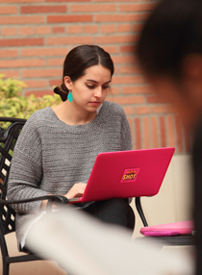
User Persona 2: Student
Name: Elizabeth Magnolia
Age: 21
Occupation: Student
Hometown: Newport Beach, CA
Attributes: adventurous, diligent, social, curious
Goals: Graduate from college and land a job in a Fortune 500 marketing position, make the most out of college experience, save money for an apartment/car/grad school
Information Sources: Facebook, Pinterest, The Daily Trojan, Cosmopolitan
Description: A California native, Elizabeth is a Marketing major at USC’s Marshall School of Business, and often studies for long hours. She is a diligent student and enjoys frequenting the bar scene in Downtown and Hollywood, often going out with many of her girlfriends.
User Scenario: Elizabeth is a member of the Millennial generation and is used to having everything accessible from her phone. She takes the Metro to do errands and visit other parts of LA, but often loses her TAP card in her messy apartment. Thus, she finds herself buying a new TAP card every so often and would much prefer it to have it on her phone.
Introduction
Project Management
System Overview
Requirements
Life Cycle Plan
Feasibility Evidence
Architecture
Prototype
Discussion

Slide 48
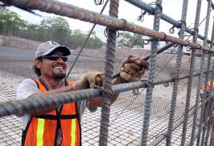
User Persona 3: Blue Collar Worker
Name: Jose Gonzales
Age: 40
Occupation: Construction Worker
Hometown: Mexico City, Mexico
Attributes: hard-working, dependable, family-man
Goals: Support his Family, Pay for kids’ college, save up for a comfortable retirement
Information Sources: LA Times, ABC News, NPR Radio
Description: Jose spent his early years in Mexico but moved to the United States at the age of 19 to pursue the American Dream. He is currently married to his wife Rosa, and they have two children, ages 8 and 12. Jose has worked very diligently over the years, often working odd, long hours. A self-made man, he was recently promoted to Construction Supervisor on one of his company’s biggest projects. He spends his weekends with his wife and kids, often at the beach or soccer field.
User Scenario: Jose does not have a car and uses the metro as his primary mode of transportation to and from work. He values the Metro’s long operating hours as he often leaves between 4-6 am every day and often works weekends. He brings a lot of equipment and documents to work and therefore finds it difficult to keep track of his TAP card. He would much prefer to have a mobile TAP system on his phone, which is always in his pocket.
Introduction
Project Management
System Overview
Requirements
Life Cycle Plan
Feasibility Evidence
Architecture
Prototype
Discussion

Slide 49

User Persona 4: Working Mom
Name: Janet Lee
Age: 31
Occupation: Sales Associate
Hometown: Downtown LA
Attributes: Busy, Enthusiastic
Goals: Help kids get to college, Earn a stable income, Promotion to management, Spend time with family
Information Sources: Facebook, Twitter, Blogs, Time magazine, co-workers and friends
Description: Janet has been in the sales business ever since she graduated college. She is married to Jeffrey with two kids, aged thee and four. Both Jeffrey and Janet work hard as they want to save money so that their kids can one day attend a top university.
User Scenario: Janet takes the Metro to work every day. Because Jeffrey starts work a lot earlier, Janet also takes her two kids with her on the Metro and drops them off at the day care before she goes to work. Janet finds it inconvenient to keep track of multiple tickets and TAP cards, as she has to buy trips for a party of three almost every time she uses the Metro. An application that allows her to buy multiple tickets or a “family pass” on one device would greatly make her daily trips a lot more efficient and convenient.
Introduction
Project Management
System Overview
Requirements
Life Cycle Plan
Feasibility Evidence
Architecture
Prototype
Discussion

Slide 50

User Persona 5: Senior Citizen
Name: Frank Mendez
Age: 68
Occupation: Retired
Hometown: Cerritos, CA
Attributes: Experienced, skeptical, relaxed
Goals: Live a relaxed, exciting and fulfilling life, watch children and grandkids go through life events
Information Sources: Radio, CNN and other TV news, The Herald Tribune and other popular newspapers
Description: Frank has been retired for the past 10 years after a successful career as a real estate agent. He currently lives with his wife, Julie, who is also retired. Frank loves to relax, visit his children and grandchildren, and play poker with his friends.
User Scenario: A member of the “baby boomer” generation, Frank has taken the Metro since he was a teenager and it has always been his preferred method of transportation. Thus, he still takes the Metro when he visits his son’s family in Westwood and to his various social events. Sometimes, Frank forgets to bring his TAP card as his memory wasn’t as good as it used to be. Because of this, Frank spends unnecessary time going back home to retrieve his TAP card. Having his phone act as his TAP card would be extremely convenient as Frank would no longer have to keep track of his TAP card.
Introduction
Project Management
System Overview
Requirements
Life Cycle Plan
Feasibility Evidence
Architecture
Prototype
Discussion

Slide 51
Discussion
Questions and Discussion
Introduction
Project Management
System Overview
Requirements
Life Cycle Plan
Feasibility Evidence
Architecture
Prototype
Discussion

